Slide 1
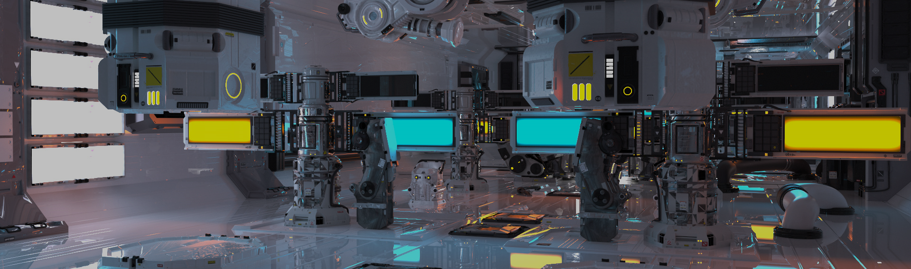
GPU Shader 4
電腦圖學導論實習
Information Technology Innovation | NTUST

Slide 2
Overview
Post-processing
Framebuffers
Advance
Homework

Slide 3
Post-processing
Performed after the usual rendering routine.
Commonly used in games while want to
Add details.
Increase reality.
Add lighting effects.
…
Extend the concept of image processing by taking a 2D image as input and outputting a manipulated image.

Slide 4
Pros and Cons
Advantages
Modifying some effects in 3D space is too expensive.
e.g. SSAA and MSAA
Too early to add the effects could be a waste.
Save the calculation time for those objects that are out of sight.
Disadvantages
Extra draw calls
Comparing to the normal rendering pipeline, post-processing usually needs to repeatedly render the result to FBO.
Lower quality for some effects
e.g. FXAA and TXAA

Slide 5

Post-processing Pipeline
(a)
(e)
(b)
(c)
(d)

Slide 6
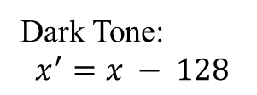
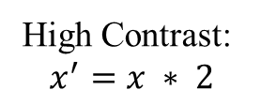
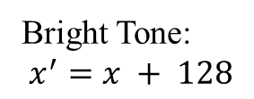
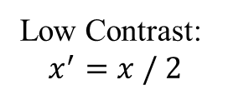
Processing Effects
The implementation of pixel operations can be easily achieved by changing the formula.
:
:
:

Slide 7
Framebuffers
https://learnopengl.com/Advanced-OpenGL/Framebuffers
Frame Buffer Object
Offline rendering
Stitching
Texture
Render Buffer Object

Slide 8
Advance
Multi-pass rendering using FBOs
Anti Aliasing
HDR
Deferred Shading
Deferred Lighting
Other Post-effect
NPR
Bloom
…
Interactive wave
Dynamic Height map

Slide 9
Dynamic Height map
Height map represent wave
Real-time Update height map
Using FBO + shader update texture
Update
Drag
https://www.youtube.com/watch?v=PFb4_HfqHbA

Slide 10
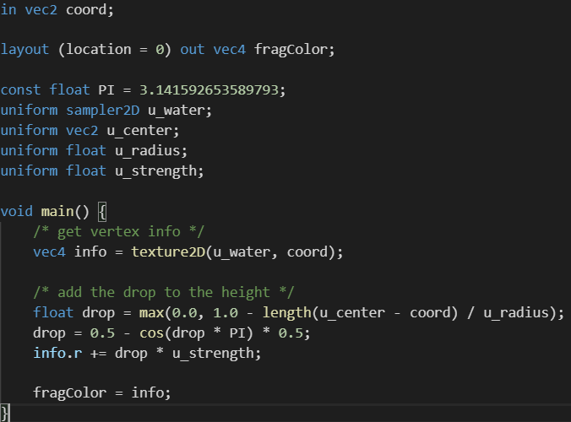
Drop
To generate a wave.
Position in texture space

Slide 11
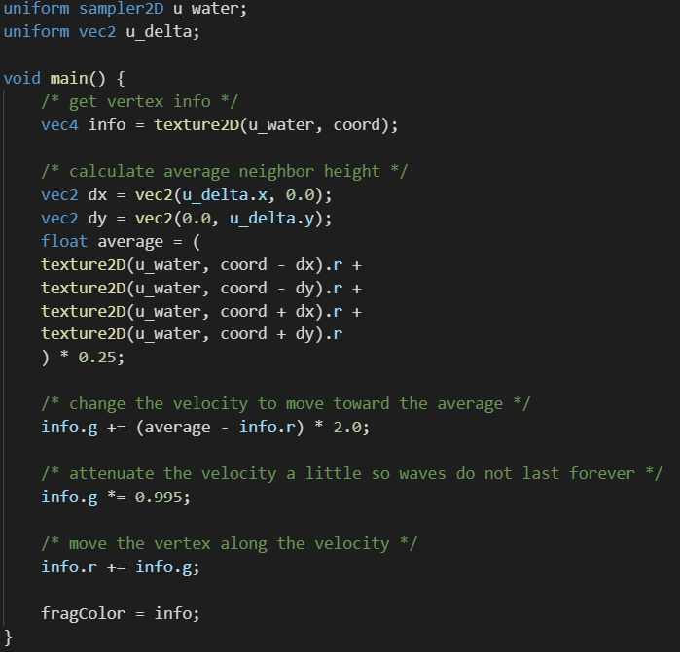
Update
The wave will gradually become calmer, and the ripples will spread outward.
To simulate ripples based on the average of neighboring pixels.

Slide 12
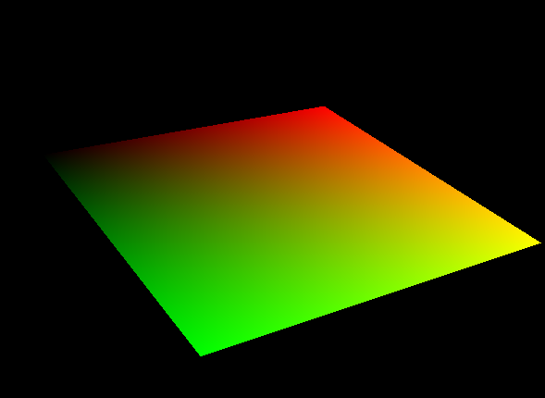

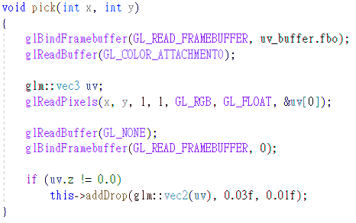
Pick
Pick mouse position in screen space to texture space
Ray cast -> fast but need to compute intersection
Off-line render texture coordinate of wave
Read pixel value
Add drop

Slide 13
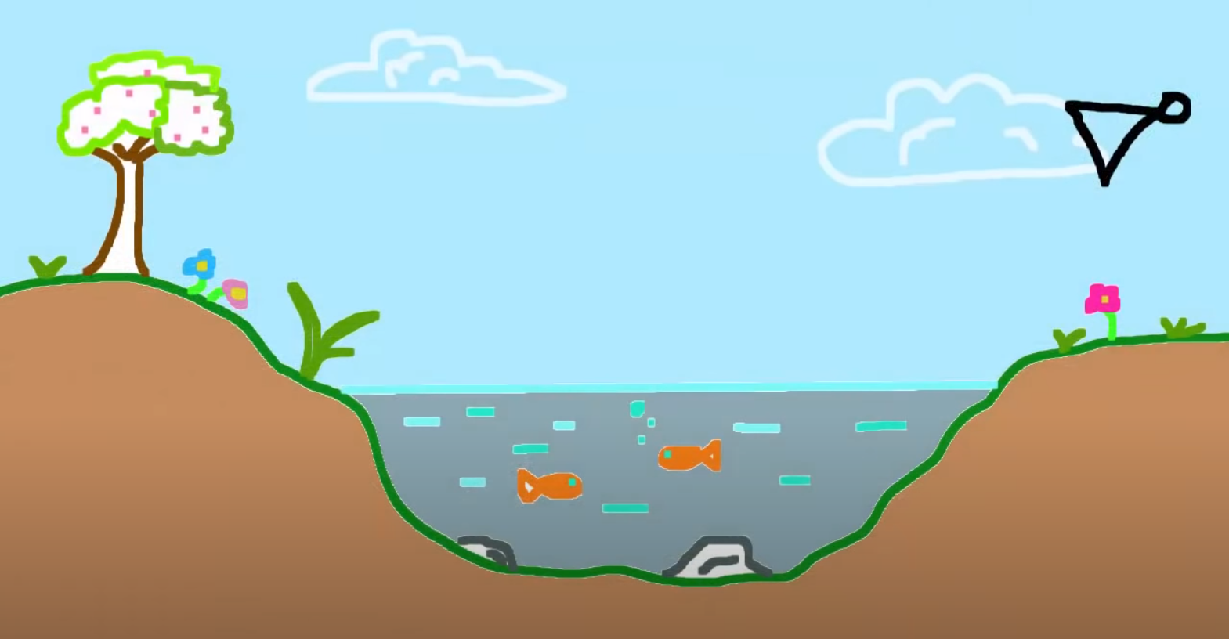

Advanced reflect & refract
https://www.youtube.com/watch?v=HusvGeEDU_U&list=PLRIWtICgwaX23jiqVByUs0bqhnalNTNZh&index=1
Refraction texture
Fresnel Effect
Lighting
Depth Effects
Output
Reflection texture

Slide 14
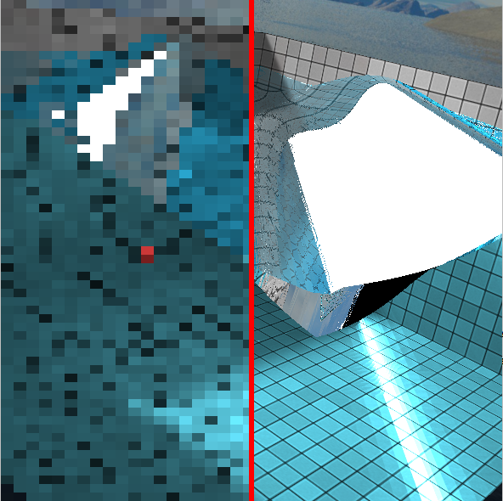
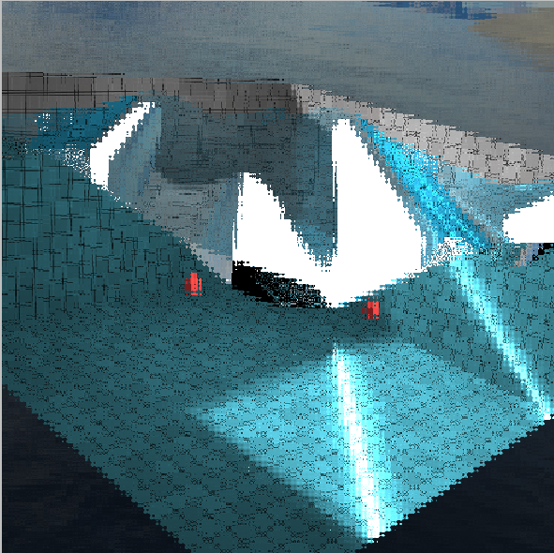
Hw12
Using FBO and shader implement effects
Pixelization
Generating ripples (Pick -> Drop -> Update)

